Slide 1

Enlightenment Ideas in the New World
The French Revolution (1789 to 1799)

Slide 2
French Revolution
marked the end of Europe’s old order of a world dominated by rich aristocrats
the beginning of a new order valuing equality, representative government, individual rights, and nationalism
occurred over the course of a decade and came in a number of stages.

Slide 3
Society under the Old Regime
In France, people were divided into three estates
  First Estate
    High-ranking members of the Church
    Privileged class
  Second Estate
    Nobility
  Third Estate
    Everyone else
    Unprivileged class

Slide 4
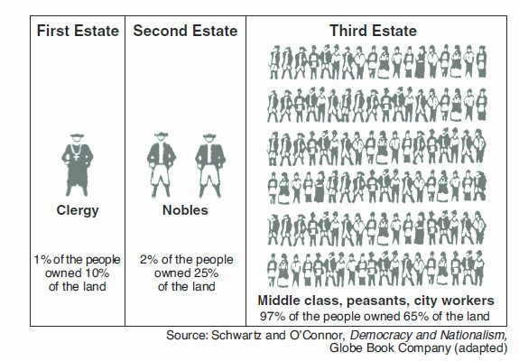

Slide 5
The Three Estates
Estate | Population | Privileges | Exemptions | Burdens
First | High-ranking clergy | Collected the taxes Censorship of the press Control of education Kept records of births, deaths, marriages, etc. Owned 10% of the land | Paid no taxes Subject to Church law rather than civil law | Moral obligation to assist the poor and needy Support the monarchy and Old Regime
Second | Nobles | Collected taxes in the form of feudal dues Monopolized military and state appointments Owned 25% of the land | Paid no taxes | Support the monarchy and Old Regime
Third | artisans, bourgeoisie, city workers, merchants, peasants, etc., | None | None | Paid all taxes Tithe (Church tax) Octrot (tax on goods brought into cities) Corvée (forced road work) Capitation (poll tax) Vingtiéme (income tax) Taille (land tax)

Slide 6

Factors of the Revolution
  Financial problems
    Taxes – peasants pay most of taxes, nobility and clergy exempt
    Debt
  Enlightenment
    Locke’s ideas of natural rights to life, liberty, property
    Locke’s ideas of the right to overthrow government if not protecting your rights

Slide 7
Effects of the Revolution
Immediate Effects
Declaration of the Rights of Man and the Citizen adopted
France adopts its first written constitution
Monarchy abolished
Long-Term Effects
Napoleon gains power
French public schools set up
French conquests spread nationalism
Revolutions occur in Europe and Latin America

Slide 8
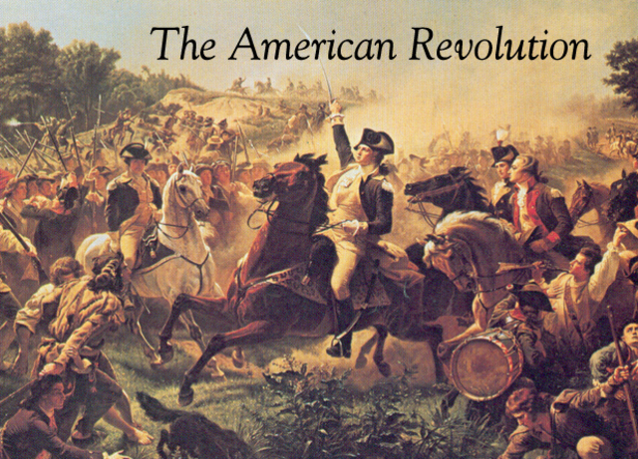

Slide 9
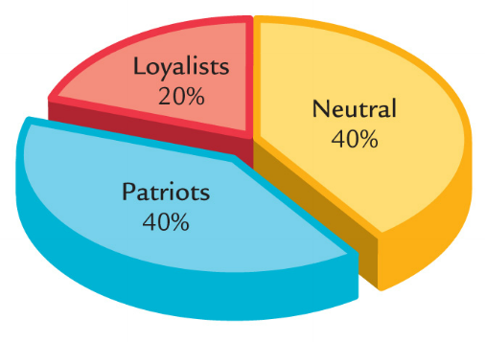
By 1776, American colonists were divided into 3 groups
Loyalists wanted to remain British colonies
Neutrals were undecided about which side to choose
Patriots supported separation from Britain (independence)

Slide 10
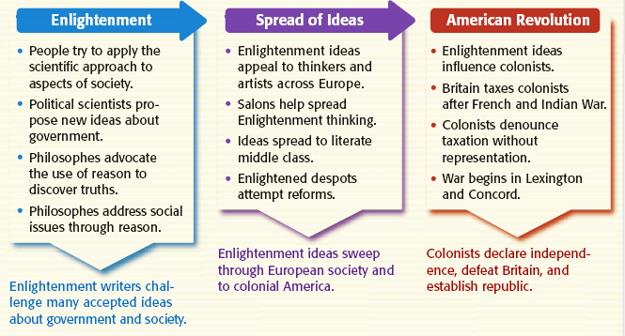
The American Revolution was
inspired by the Enlightenment
John Locke—all men are born with natural rights & citizens can revolt from tyrannical gov’ts
  Thomas Paine’s
  Common Sense urged colonial independence

Slide 11
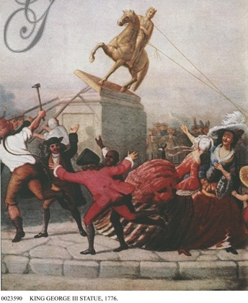

By July 1776, _x000b_how had colonial attitudes towards _x000b_Great Britain changed?

Slide 12
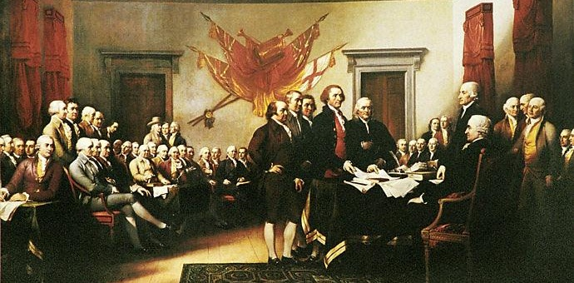
By July 1776, enough Americans were “patriots” that members of
the Second Continental Congress
formed a 5-man committee to
draft a Declaration of Independence
Thomas Jefferson of Virginia was the principal author
All men are born with “natural rights” of life, liberty, & property
Citizens can break their social contract with their gov’t when their gov’t becomes tyrannical
It was based on the “enlightened” ideas of John Locke & explained why the colonists were rebelling

Slide 13
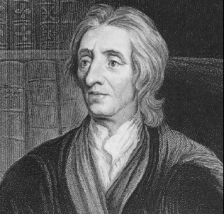
John Locke
Said people have rights that are above that of the good of society.
  They include life, liberty, and property.
  Governments and leaders only exist to protect these rights.
  There is no such thing as absolute power.
The state of nature for man is freedom.

Slide 14
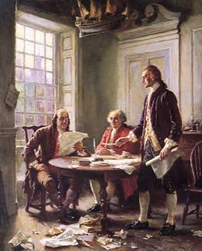
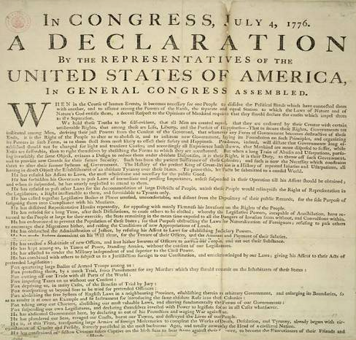
Declaration of Independence (July 4, 1776)
Committee to draft the Declaration: Thomas Jefferson, Ben Franklin, John Adams, Robert Livingston, & Roger Sherman

Slide 15
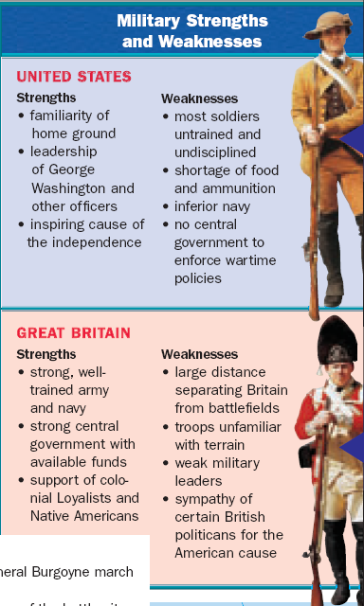
Revolutionary War
When the war began, the British had a clear military advantage:
  400% larger & more experienced army
  More money
  The world’s most dominant navy
  Manufacturing to make war supplies

Slide 16
Revolutionary War
Britain under-estimated the colonial commitment to independence
But, the American colonists had:
  Familiarity with the environment
  A commitment to win the war
  Short supply lines to their soldiers
  A defensive strategy to outlast the British

Slide 17
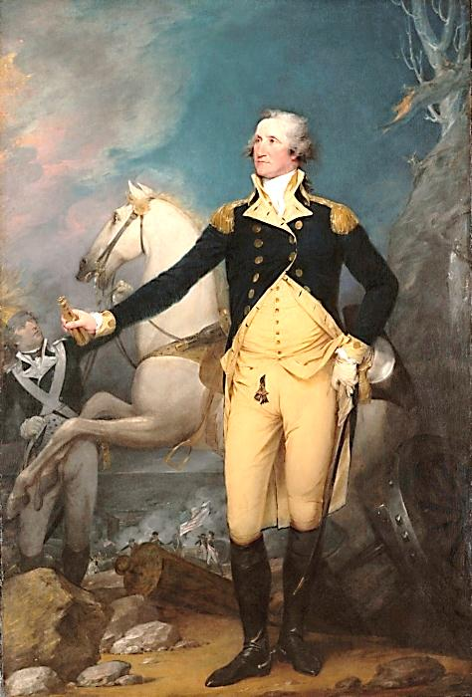
As leader of the Continental Army, George Washington
was the symbol of the American cause
He had to build a professional army & coordinate the militias
Encouraged common citizens & volunteer soldiers to support the war even when the British seemed destined to win during the early years of the revolution

Slide 18
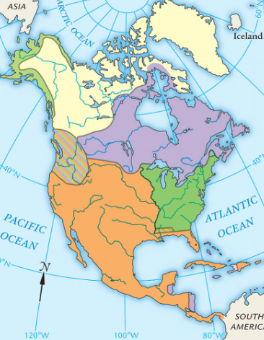

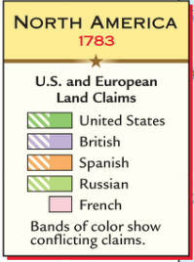
The Treaty of Paris in 1783 ended the American Revolution
The treaty gave America:
Full independence
All territory east of Mississippi River, between Canada
& Florida
The removal of
the British army from U.S. claims
in America

Slide 19
https://www.youtube.com/watch?v=0JLvRJzvOic

